Slide 1
Mentor Introductions
SIMCODES 2025

Slide 2
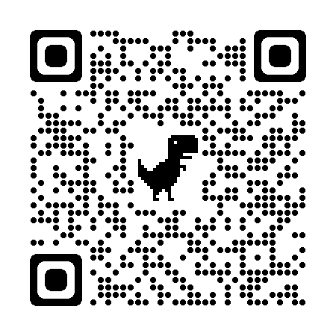
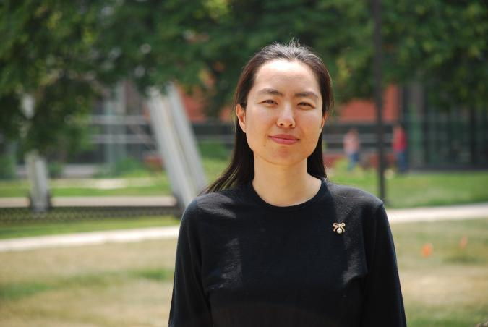
Qi Li
My name
Name can tell a lot
Gender, Ethnicity, Age, Religion, …
Important feature for many NLP tasks
My background
BS. Math
MS. Stats
PhD. CS
Computer Science

Slide 3
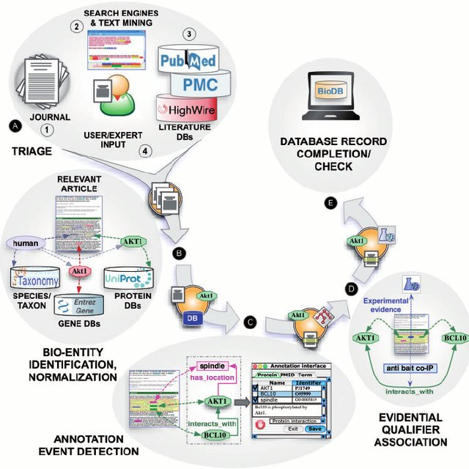

My research
NLP -- Information extraction
Generation models
Applied ML
Knowledge & Insights
Computer Science

Slide 4
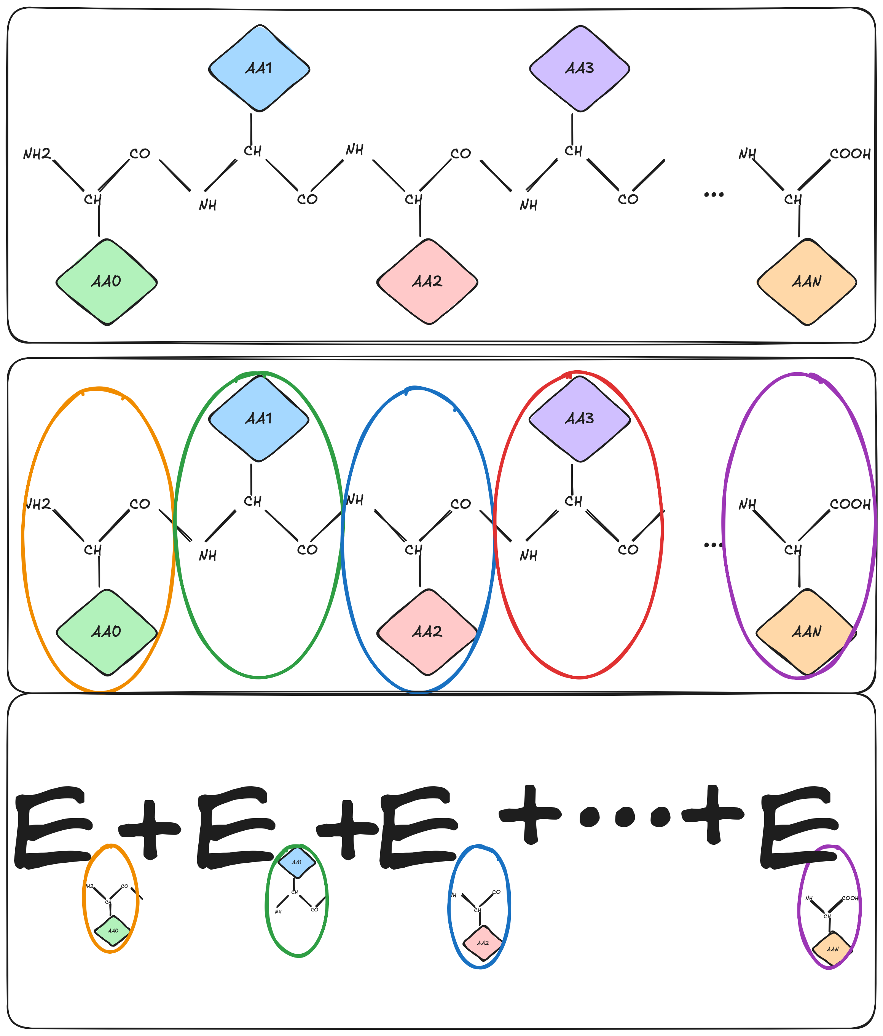
SIMCODES Project: Developing components for automating fragmentation
Mentee: Gabriela and Devarsh
Goals:
Function for identifying amino acids in a protein.
Function for splitting a protein by amino acid.
Idea: protein as an unnatural language
Computer Science

Slide 5
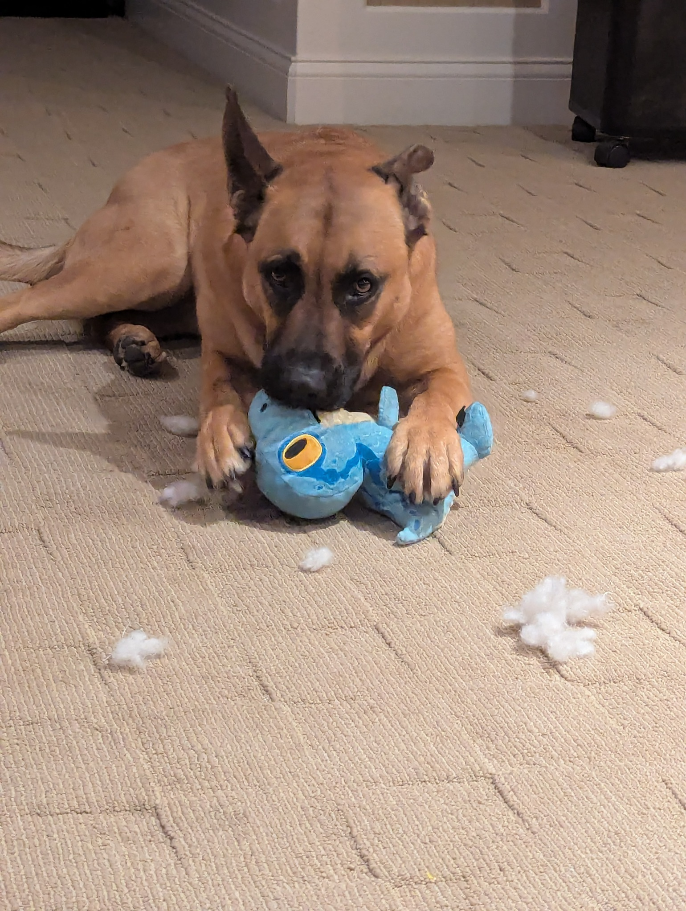
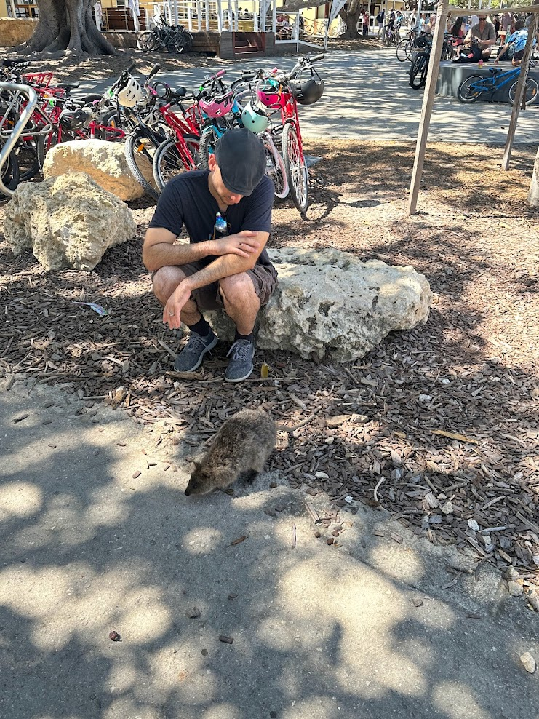
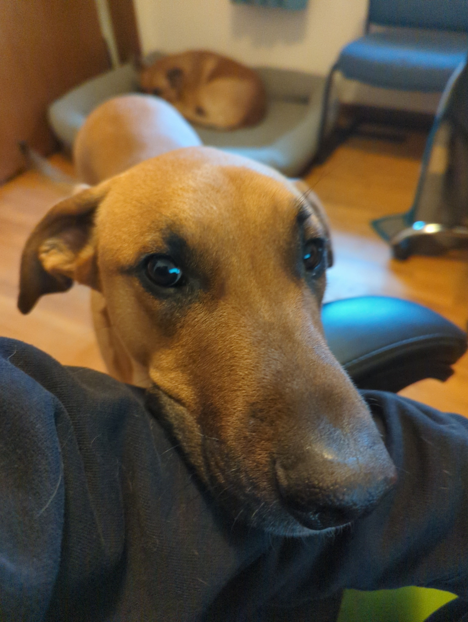
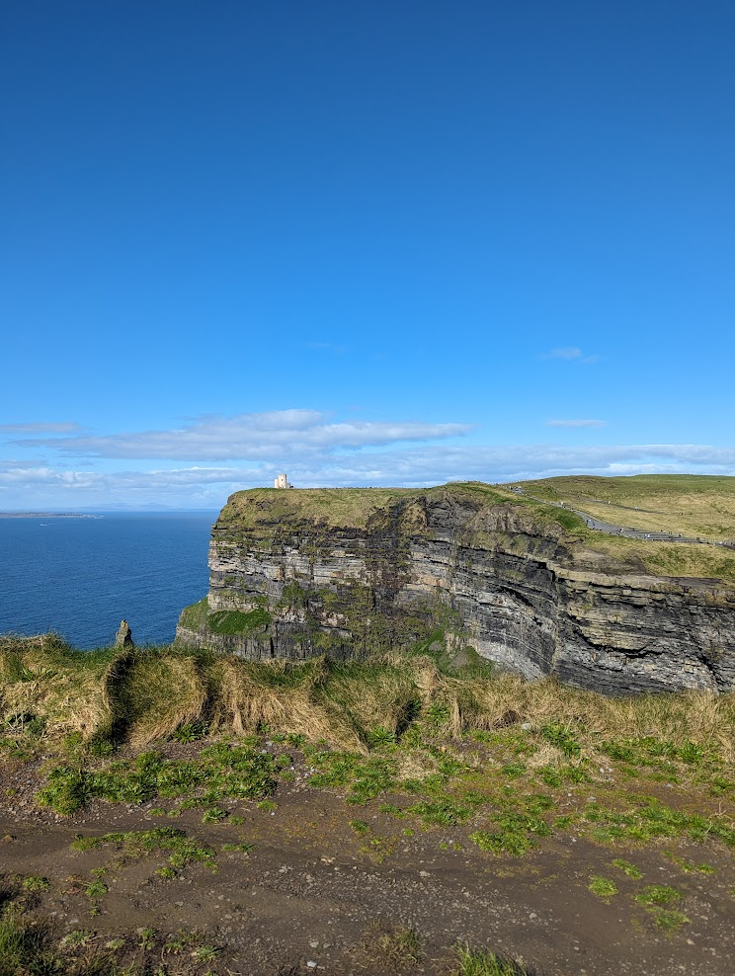
Ryan Richard
Scientist at Ames National Laboratory and Adjunct Professor of Chemistry at Iowa State University.
Background: Grew up in Ohio, PhD in chemistry from “The” Ohio State University.
Interests: travel, technology, video games, exercise, being told what to do by my dogs.

Slide 6
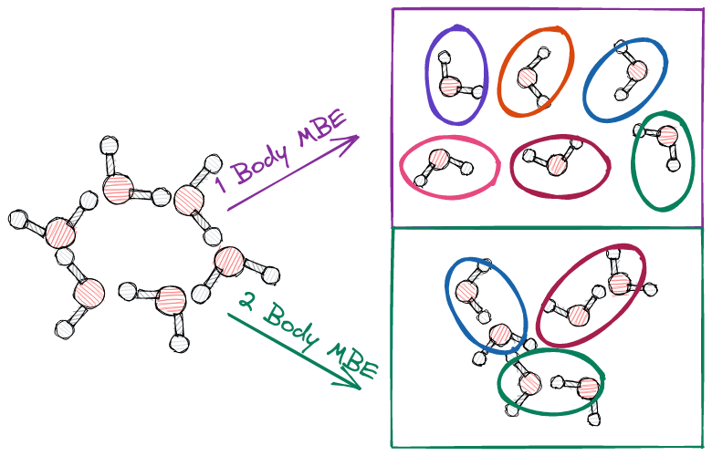
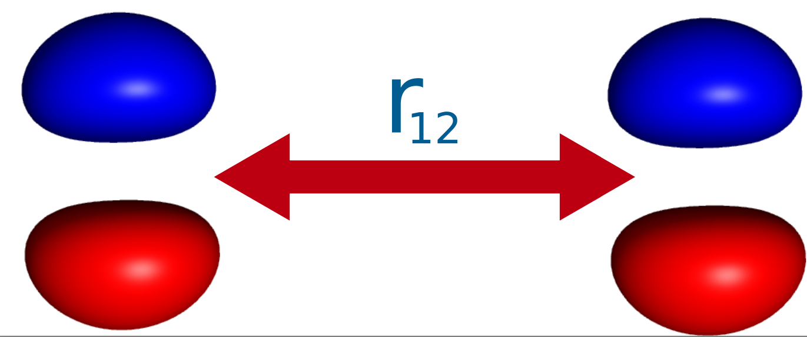
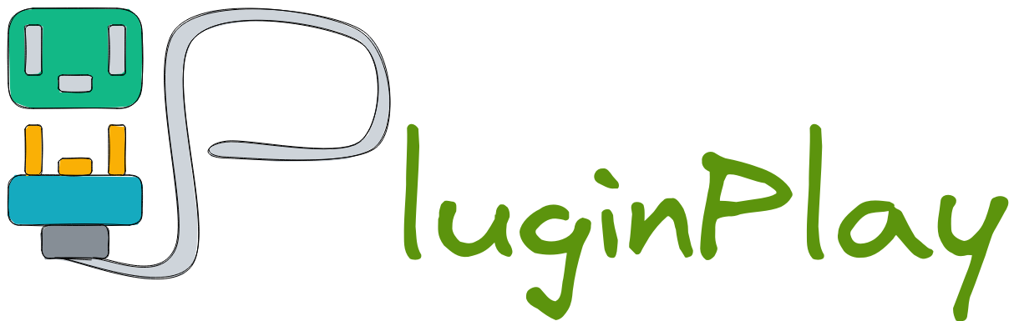
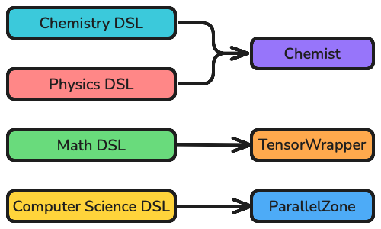

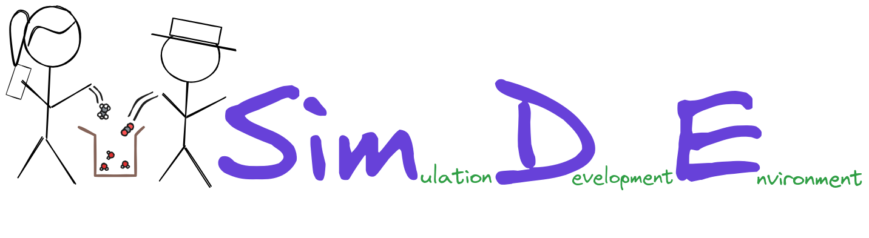
Research in the Richard Group
Research interests: Sustainable scientific software development, high-performance computing, reduced scaling electronic structure theory.
Develop for NWChemEx ecosystem.
Strong emphasis on software engineering applied to theoretical chemistry.
Notes:
The Richard group actively develops software that relies on physics models to predict and explain chemistry. We are particularly interested in developing “reduced scaling techniques”. Fragment-based methods compute the properties of large chemical systems by systematically including molecular interactions. On the other hand, DLPNO-CC systematically includes intramolecular interactions. Both methods have shown great promise in making electronic structure methods more applicable. Our group develops software to be part of the NWChemEx ecosystem.

Slide 7
SIMCODES Project: Developing components for automating fragmentation
Mentee: Daniel Woodard
Summary: Winner-take-all battle between Daniel’s chemical intuition and the best AI/ML model Gabriela and Devarsh can make.
Goals:
Develop tools for reading PDF files.
Function for identifying amino acids in a protein.
Function for splitting a protein by amino acid.

Slide 8
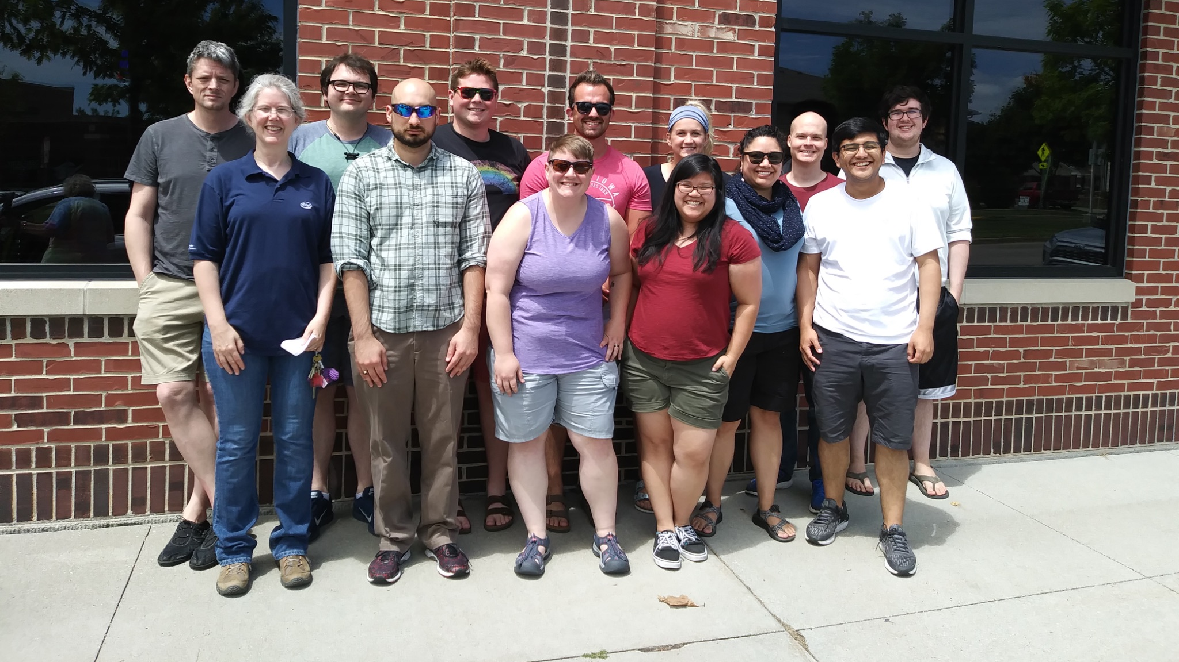
The Richard and Windus Groups
Notes:
The Richard group currently consists of 1 undergraduate student and 3 graduate students. Since Ryan is an adjunct professor he must co-advise graduate students. In practice, this means most students are co-advised by Prof. Theresa Windus (the principal investigator of the NWChemEx project). Other co-advising situations are possible, for example, one graduate student is currently co-advised by Prof. Davit Potoyan.

